Slide 1

ARTIFICIAL INTELLIGENCE
IN
SMART CITIES

Slide 2
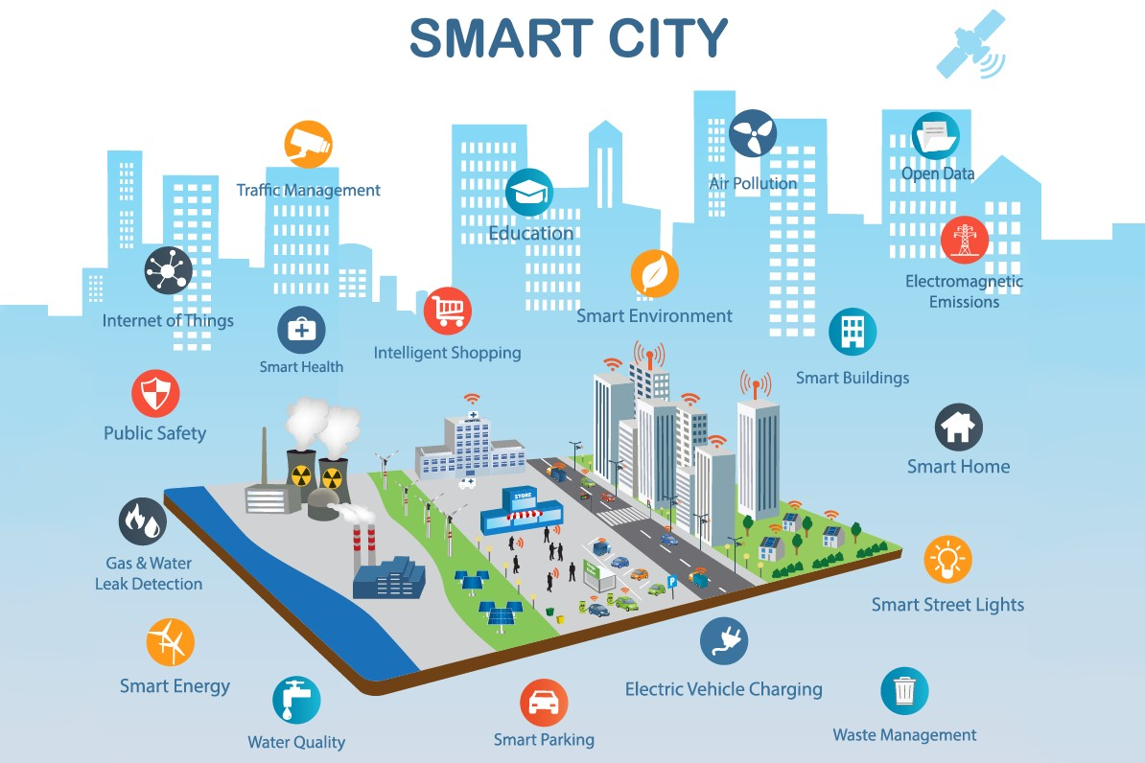
INTRODUCTION
Introduction to AI in Smart Cities: Artificial Intelligence (AI) is a rapidly evolving field that has the potential to transform the way we live and work. One area where AI is already making a significant impact is in the development of smart cities. A smart city is a city that uses technology and data to improve the lives of its residents, enhance sustainability, and streamline city operations.
The integration of artificial intelligence (AI) technology in smart cities has become increasingly popular in recent years. AI has the potential to revolutionize the way cities operate by optimizing infrastructure, improving public services, and enhancing the overall quality of life for citizens. This project aims to explore the role of AI in smart cities and how it can be utilized to create more efficient and sustainable urban environments.
Figure 1: Smart Cities Component
5

Slide 3
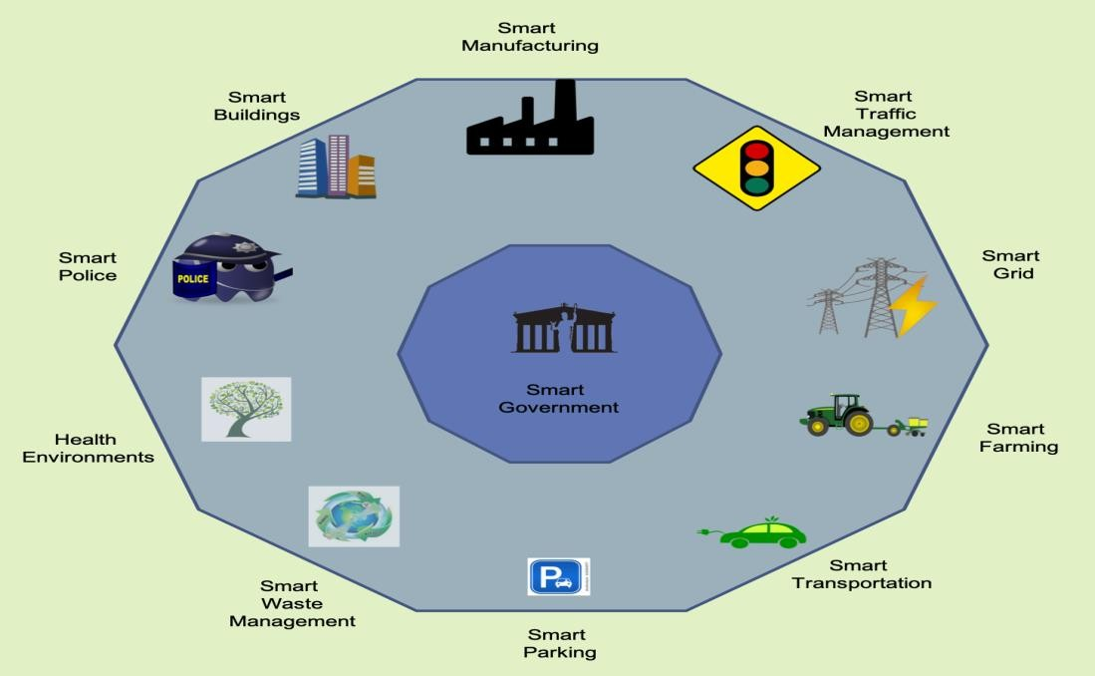
Sub-Headings
1.1 Potential use cases of AI in Smart Cities: This sub-heading could focus on the various benefits that AI technology can bring to smart cities, such as improved infrastructure, enhanced public services, and increased efficiency and sustainability.
Public transit. Cities with vast transit infrastructure and systems can benefit from applications that harmonise the experience of its riders. Passengers of trains, buses and cars can provide real-time information through their mobile apps to communicate delays, breakdowns and less congested routes.
Public safety. The same networks of sensors and cameras can be used to save lives and lower crime. Traffic lights and congestion data can be used by emergency services to get to their destinations quicker and more safely. Cities can gather data on accidents or choose other factors to measure in order to develop predictive and preventative measures for the future.
Power grids. AI and Smart Cities have the potential to enhance the safety of power grids and improve performance management.
Figure 2: Use cases for a smart city:
6

Slide 4
1.2 Challenges and Ethical Implications of AI in Smart Cities: This sub-heading could explore some of the potential challenges and ethical concerns associated with the integration of AI in smart cities, such as privacy, security, and the potential for bias and discrimination.
Privacy and data protection: AI systems in smart cities collect vast amounts of data on citizens, including personal information such as location, behavior, and preferences. It is important to ensure that this data is protected and that citizens' privacy rights are respected.
Security and safety: AI systems in smart cities may be vulnerable to cyberattacks or other security threats. It is important to ensure that these systems are secure and that they do not pose a risk to public safety.
Ethical governance: There should be clear guidelines and ethical principles in place to govern the use of AI in smart cities. This includes ensuring that these systems are developed and deployed in a way that aligns with societal values and principles, and that they are subject to appropriate oversight and regulation.
Bias and discrimination: AI systems are only as good as the data they are trained on. If the data used to train these systems is biased, then the results will be biased as well. This can lead to discrimination against certain groups of people, such as those from marginalized communities.
7

Slide 5
DIFFERENT APPLICATIONS OF AI IN SMART CITIES
Artificial Intelligence (AI) is playing an increasingly important role in the development of smart cities. There are several different applications of AI in smart cities that can help improve efficiency, sustainability, and quality of life for citizens. Here are some examples:
2.1 Traffic management: AI can be used to optimize traffic flow, reduce congestion, and improve safety on city streets. This can be achieved through technologies such as predictive traffic modeling, smart traffic signals, and autonomous vehicles.
2.2 Energy Management: AI can be used to optimize energy consumption by monitoring energy usage, predicting demand, and adjusting supply to match the demand.
AI can be used to optimize energy consumption in buildings and infrastructure, reducing energy waste and lowering costs. This can be achieved through technologies such as smart lighting and heating systems, and energy-efficient building design.
8

Slide 6
2.3 Waste management: AI can be used to optimize waste collection routes, identify areas with the highest waste production and reducing waste volumes and improving recycling rates. This can be achieved through technologies such as smart waste bins and predictive waste collection.
2.4 Public safety: AI can be used to enhance public safety by detecting and predicting criminal activity, identifying potential hazards, and providing real-time emergency response. This can be achieved through technologies such as predictive policing, surveillance systems, and emergency response management.
2.5 Smart Homes: AI can be used to automate home appliances, optimize energy consumption, and enhance security.
AI can be used to optimize building operations and maintenance, reducing costs and improving energy efficiency. This can be achieved through technologies such as building automation systems and predictive maintenance.
2.6 Urban planning: AI can be used to optimize urban planning and development, improving the design and functionality of cities. This can be achieved through technologies such as predictive land- use modeling and 3D urban visualization.
9

Slide 7
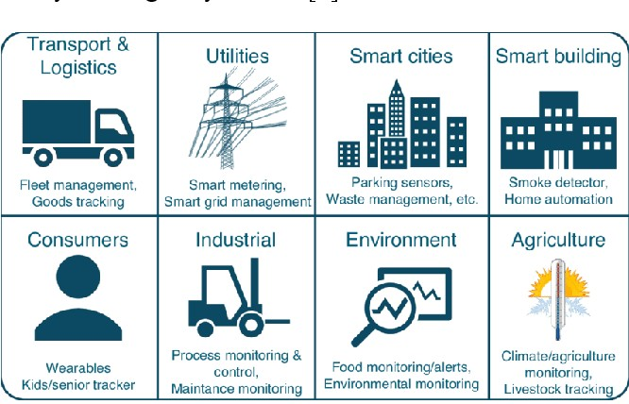
2.7 Healthcare: AI can be used to monitor public health, identify outbreaks, and optimize
healthcare resources.
2.8 Citizen engagement: AI can be used to enhance citizen engagement and participation in city decision-making. This can be achieved through technologies such as chatbots and virtual assistants, which can provide information and services to citizens and help them navigate city services and resources.
Figure 3: Applications of IoT
10

Slide 8
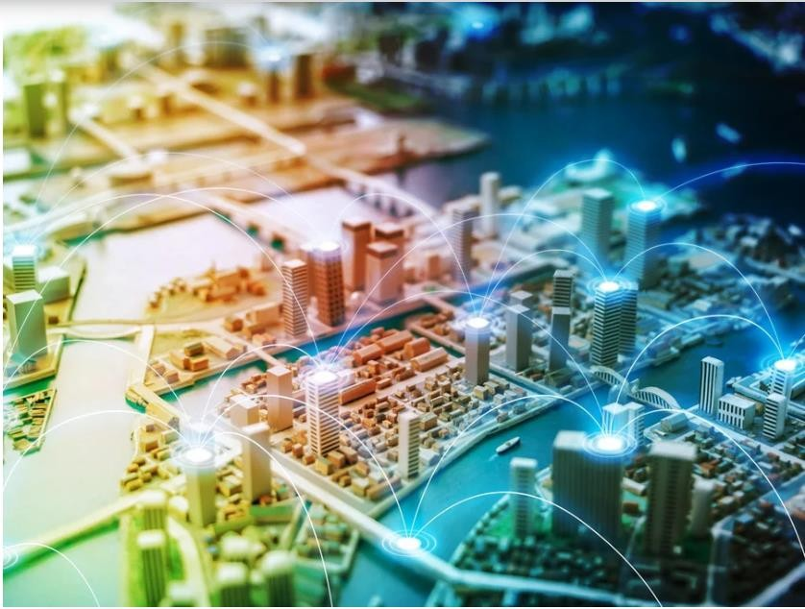
IMPACT OF AI IN SMART CITIES
Artificial intelligence (AI) has the potential to greatly impact smart cities by improving efficiency, reducing costs, and enhancing the quality of life for residents. Here are some of the ways in which AI is already making an impact in smart cities.
Smart cities can use AI to see their effect on the local environment, global warming, as well as pollution levels. Using AI and machine learning for pollution control and energy consumption, allows authorities and cities to make well-informed decisions that are best for the environment.
Figure 4: AI and IoT help bring about a smart city experience
11

Slide 9
3.1 Improved Traffic Management: AI-powered traffic management systems can help reduce congestion, optimize traffic flow, and enhance road safety. For example, real-time traffic data can be collected from cameras and sensors, and analyzed to optimize traffic signal timings, reroute vehicles, and prevent accidents.
AI-based traffic management systems can also be used to optimize the use of public transport systems, such as buses and trains. By analyzing data on passenger flows and traffic patterns, AI algorithms can be used to adjust the frequency and routing of public transport services to better meet the needs of commuters.
Another approach to AI-based traffic management is to use predictive algorithms to anticipate traffic patterns and adjust traffic flow accordingly. For example, if an event is expected to draw a large number of people to a particular area, traffic management systems can be adjusted to accommodate this influx of traffic and prevent congestion.
Overall, the use of AI in traffic management systems in smart cities has the potential to greatly improve the efficiency of urban transport systems, reduce traffic congestion and air pollution, and improve the overall quality of life for city residents.

Slide 10
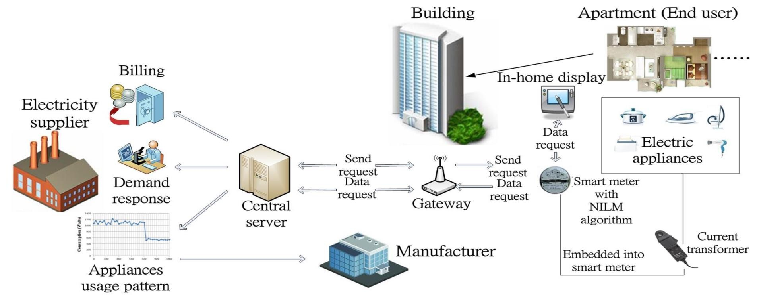
3.2 Enhanced Energy Management: AI can be used to optimize energy consumption in smart buildings and homes. For instance, smart thermostats can learn occupants' behavior and adjust heating and cooling settings to conserve energy. AI can also be used to manage renewable energy sources like solar and wind power.
Through the use of real-time data, Enhanced Energy Management systems can predict energy demand and supply, identify energy inefficiencies, and optimize energy usage to reduce waste and lower carbon emissions. This can be done by implementing various strategies such as load shifting, demand response, and energy storage management.
Figure 5: Energy Sustainability in Smart Cities

Slide 11
3.3 Improved Public Safety: AI can be used to enhance public safety by analyzing real- time data from surveillance cameras and sensors to detect potential threats, such as accidents, crimes, and fires. AI can also be used to alert emergency services and dispatch the appropriate response teams.
AI can be used to analyze data from security cameras, sensors, and other sources to detect and
prevent crime, and to respond quickly to emergencies.
Predictive Policing: AI-powered predictive policing systems can help law enforcement agencies predict where crimes are likely to occur based on historical crime data and other factors such as weather, time of day, and local events. This can help prevent crime and enable police to respond more quickly and efficiently.
Emergency Response: AI-powered emergency response systems can help emergency services respond more quickly and efficiently to emergencies such as natural disasters, accidents, and terrorist attacks. For example, AI can be used to analyze real-time data from social media, traffic cameras, and other sources to identify the location and severity of an emergency and dispatch the appropriate response team.

Slide 12
3.4 Enhanced Healthcare: AI-powered healthcare systems can help improve patient outcomes and reduce healthcare costs. For example, AI algorithms can be used to analyze medical data and predict patient outcomes, enabling doctors to provide personalized treatment plans. AI can also be used to manage healthcare resources and optimize hospital operations.
There are some more important points on how AI can enhance healthcare in smart cities:
Medical Diagnosis: AI-powered medical diagnosis systems can help doctors diagnose diseases and provide personalized treatment plans. For example, AI algorithms can analyze medical data such as images and lab results to identify patterns and anomalies that may be missed by human doctors.
Remote Patient Monitoring: AI-powered remote patient monitoring systems can help doctors monitor patients outside of the hospital, reducing healthcare costs and improving patient outcomes. These systems use sensors and wearables to monitor vital signs and health data, and AI algorithms can analyze the data to detect changes and alert doctors to potential health issues.
Drug Discovery: AI can be used to accelerate drug discovery and development, reducing the time and cost of bringing new drugs to market. AI algorithms can analyze large datasets to identify potential drug candidates, predict their efficacy and toxicity, and recommend the best drug development strategies.

Slide 13
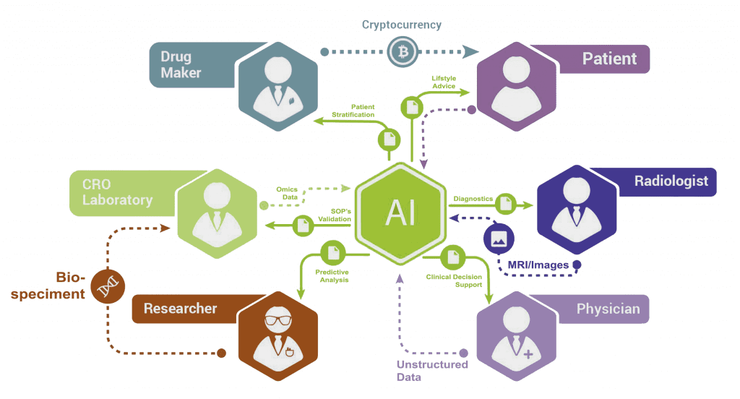
Healthcare Resource Management: AI can be used to optimize healthcare resource management in smart cities, improving efficiency and reducing costs. For example, AI algorithms can analyze hospital data to predict patient flow, optimize staffing, and reduce wait times.
Personalized Medicine: AI-powered personalized medicine systems can help doctors tailor treatments to individual patients based on their unique genetics, lifestyle, and medical history. For example, AI algorithms can analyze patient data to predict their response to different treatments and recommend the most effective course of action.
Figure 6: Smart Health Care System

Slide 14
3.5 Improved Air Quality: AI-powered air quality monitoring systems can help detect pollution levels and identify sources of pollution. For example, sensors can be installed throughout the city to monitor air quality, and AI algorithms can be used to analyze the data and provide real-time alerts and recommendations.
Real-time monitoring: AI-powered sensors can be installed in various locations throughout the city to collect data on air quality in real-time. This can help identify areas where pollution is high, and take immediate action to improve air quality.
Predictive modeling: AI can use historical data to create predictive models that can forecast air pollution levels. This can help city planners to take proactive measures to reduce pollution levels, such as traffic rerouting or adjusting factory schedules.
Indoor air quality monitoring: AI-powered sensors can also be installed in buildings to monitor indoor air quality. This can help identify sources of pollution and provide recommendations on how to improve air quality indoors.
Environmental policy optimization: AI can analyze the effectiveness of current environmental policies and suggest changes that could improve air quality. This can help city governments to make informed decisions that can have a positive impact on air quality.

Slide 15
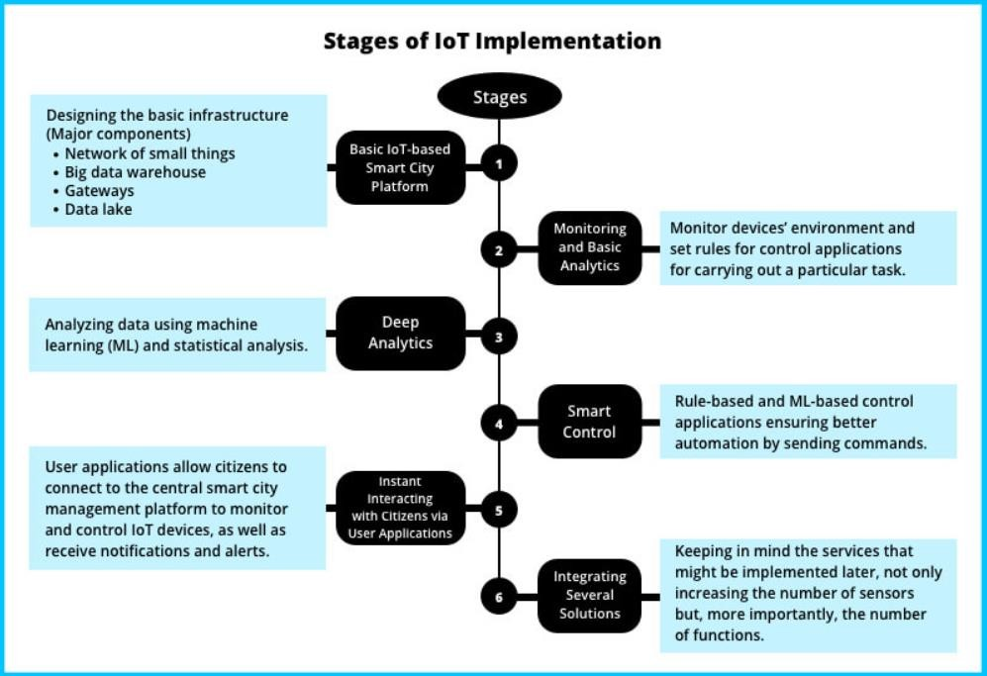
FUTURE SCOPE
The integration of AI technology in smart cities is expected to revolutionize urban life by enhancing efficiency, sustainability, and safety. AI can help to optimize the use of resources, enable better decision-making, and improve citizen services. As cities continue to grow and become more complex, AI technology will play an increasingly important role in managing urban environments.
Figure 7: scalable IoT architecture for a smart city.

Slide 16
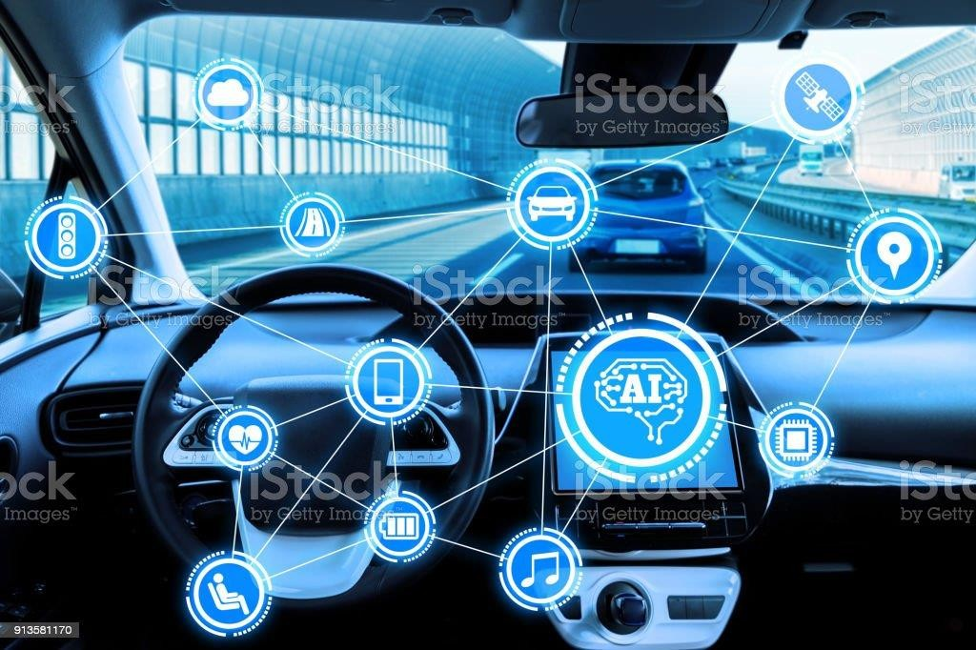
4.1 Autonomous vehicles: AI-powered Self-driving cars and other autonomous vehicles will play a key role in future smart cities, reducing traffic congestion and increasing safety. AI algorithms can help these vehicles to navigate complex urban environments, detect obstacles and avoid collisions.
Autonomous vehicles, including self-driving cars and other types of transportation, have the potential to significantly transform the way people move around in cities.
Figure 8: Self driving car

Slide 17
4.2 Intelligent traffic management: AI algorithms can be used to optimize traffic flow, reduce congestion, and improve safety on city streets. By analyzing data from traffic sensors and cameras, AI systems can adjust traffic lights and signage to ensure efficient and safe movement of vehicles.
Intelligent traffic management involves using AI and other advanced technologies to optimize traffic flow and reduce congestion on city streets. This can help improve transportation efficiency, reduce emissions, and improve safety for drivers, pedestrians, and cyclists.There are some ways that AI can be used for intelligent traffic management
Real-time traffic monitoring: AI algorithms can analyze data from traffic sensors, cameras, and other sources in real-time to monitor traffic flow and identify areas of congestion. This information can be used to optimize traffic signals and adjust traffic flow to reduce congestion.
Predictive traffic analysis: AI can be used to predict traffic patterns and anticipate areas of congestion before they occur. This can help traffic management systems adjust traffic flow and minimize the impact of congestion on drivers and pedestrians.

Slide 18
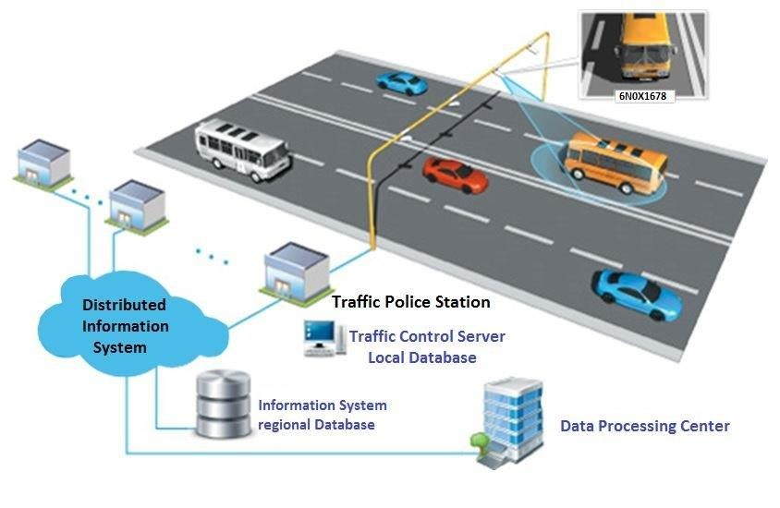
Incident detection and response: AI algorithms can monitor traffic data for incidents such as accidents or road closures, and provide real-time alerts to traffic management systems. This can help reduce response times and minimize the impact of incidents on traffic flow.
Dynamic speed limits: AI can be used to adjust speed limits based on real-time traffic data, helping to reduce congestion and improve safety on city streets.
Figure 9: Traffic Management System
21

Slide 19
4.3 Improved Safety and Security through Intelligent Surveillance: AI-powered cameras and sensors can enhance public safety and emergency response by identifying potential threats and alerting authorities.
Improved safety and security through intelligent surveillance is a potential area where AI can make a significant impact in smart cities. By integrating advanced machine learning algorithms with video cameras and other sensors, cities can identify potential threats in real- time, enhancing public safety and emergency response.
AI-powered surveillance systems can recognize and classify people and objects, analyze behavioral patterns, and flag unusual or suspicious activities, providing security personnel with real-time alerts and situational awareness. This can enable rapid response to emergencies, such as natural disasters, accidents, or acts of terrorism, improving the overall safety of the city.
Moreover, intelligent surveillance systems can improve law enforcement efforts by identifying and tracking potential suspects, investigating crimes, and providing evidence for court cases. This can help prevent crime and promote justice, leading to safer communities and better quality of life for residents.
22

Slide 20
4.4 Enhanced Citizen Engagement through Smart Services: AI can facilitate citizen participation in decision-making and improve access to public services through personalized, automated assistance.
Enhanced citizen engagement through smart services is another potential area where AI can make a significant impact in smart cities. By integrating advanced machine learning algorithms with digital platforms and services, cities can provide personalized, automated assistance to citizens, improving access to public services and promoting civic participation.
AI-powered smart services can provide real-time information and feedback on a wide range of topics, such as transportation, public safety, healthcare, education, and environmental sustainability. Citizens can use chatbots, mobile apps, and other digital tools to access information, request services, and provide feedback to city authorities.
It is important to note that smart services must be developed and implemented with care to ensure they meet citizens' needs, are accessible to all, and respect individuals' privacy rights. To build public trust, cities must be transparent about how they use citizen data, provide clear and user-friendly interfaces, and ensure equitable access to digital services for all residents.
23

Slide 21
4.5 Infrastructure and Resource Management: How AI can optimize the management of resources such as energy, water, and transportation to make cities more sustainable and efficient.
Infrastructure and resource management refers to the use of technology and data to optimize the use of resources such as energy, water, and transportation in cities. The goal is to improve efficiency and reduce waste, resulting in a more sustainable and cost-effective urban environment.
Artificial Intelligence (AI) can play a crucial role in infrastructure and resource management in smart cities. By analyzing data from sensors and other sources, AI algorithms can identify patterns and trends to inform decision-making and optimize resource allocation. For example, machine learning algorithms can analyze traffic patterns to optimize traffic flow and reduce congestion, or they can analyze weather patterns to optimize energy usage and reduce waste.
Water resource management is another area where AI can make significant contributions. By analyzing data from water sensors and other sources, AI algorithms can identify patterns of water usage and predict demand, enabling better allocation of resources and reducing waste. AI can also help to detect leaks and other issues in water infrastructure, reducing the amount of water lost due to leakage.
24

Slide 22
AI IN SMART CITY
Advantages | Disadvantages
1) Better connectivity | 1) Lack of social control
2) Reduce carbon footprint | 2) Still under development
3) Efficient public services | 3) Difficulty in the pre-commerce stage
4) Less crime | 4) Security concerns and data privacy concerns
5) Improved infrastructure | 5) Difficult to release the business case for implementation
6) More job opportunities | 6) Excess network trust
7) Safer communication | 7) Limited privacy
8) Better connectivity | 8) Lack of social control

Slide 23
CONCLUSION
Artificial intelligence (AI) has the potential to revolutionize the way we live and interact with the world, and smart cities are no exception. In fact, AI is increasingly being used in smart city applications to improve everything from traffic flow and public safety to energy efficiency and waste management.
AI-powered sensors, cameras, and other smart city technologies are being deployed to collect data and analyze it in real-time, enabling city officials to make better decisions and respond more quickly to changing conditions. AI is also being used to develop predictive models that can anticipate future events and help city officials prepare for them.
While there are certainly challenges to implementing AI in smart cities, including issues related to data privacy and security, the potential benefits are significant. By leveraging AI, smart cities can become more efficient, sustainable, and livable, improving the quality of life for their residents and setting the stage for a more prosperous future.
25

Slide 24

THANK YOU

